Slide 1

BASIC ELECTRICAL AND ELECTRONICS ENGINEERING
Course Code: CSE1002
SCHOOL OF COMPUTER SCIENCE ENGINEERING AND APPLICATIONS
Mrunmayee Rahate
Assistant Professor, DYPIU

Slide 2
Module 1: Fundamentals of Electrical Circuits
Lecture 5:
Network Theorems: Thevenin’s Theorem

Slide 3
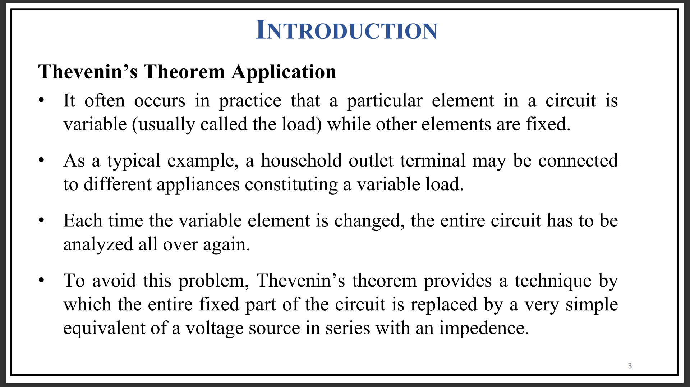

Slide 4
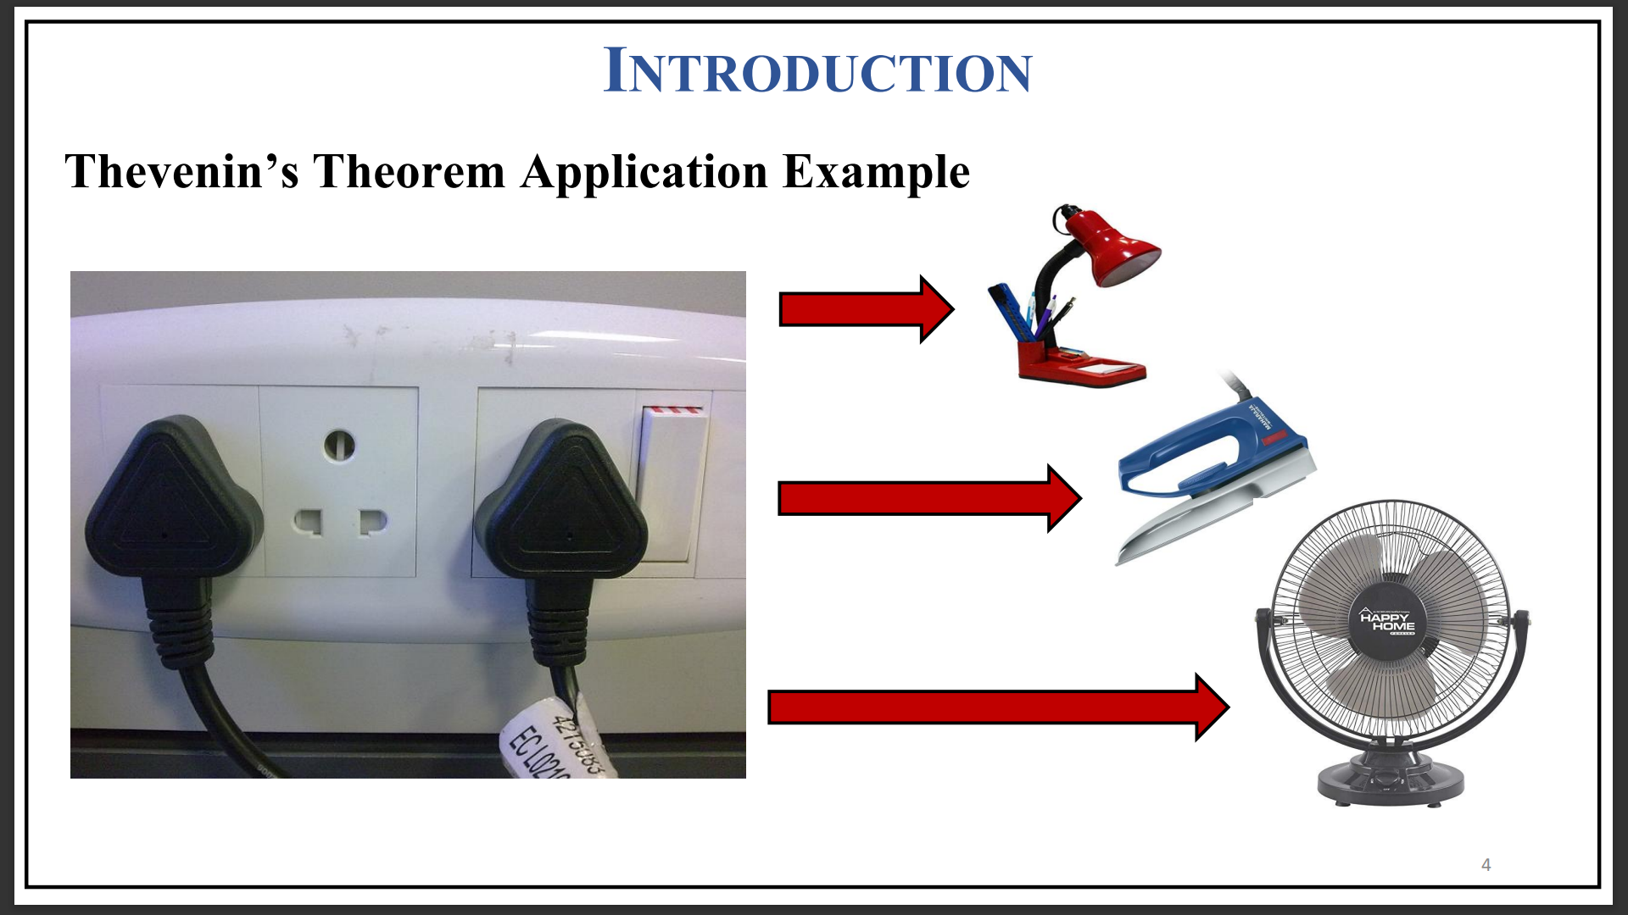

Slide 5
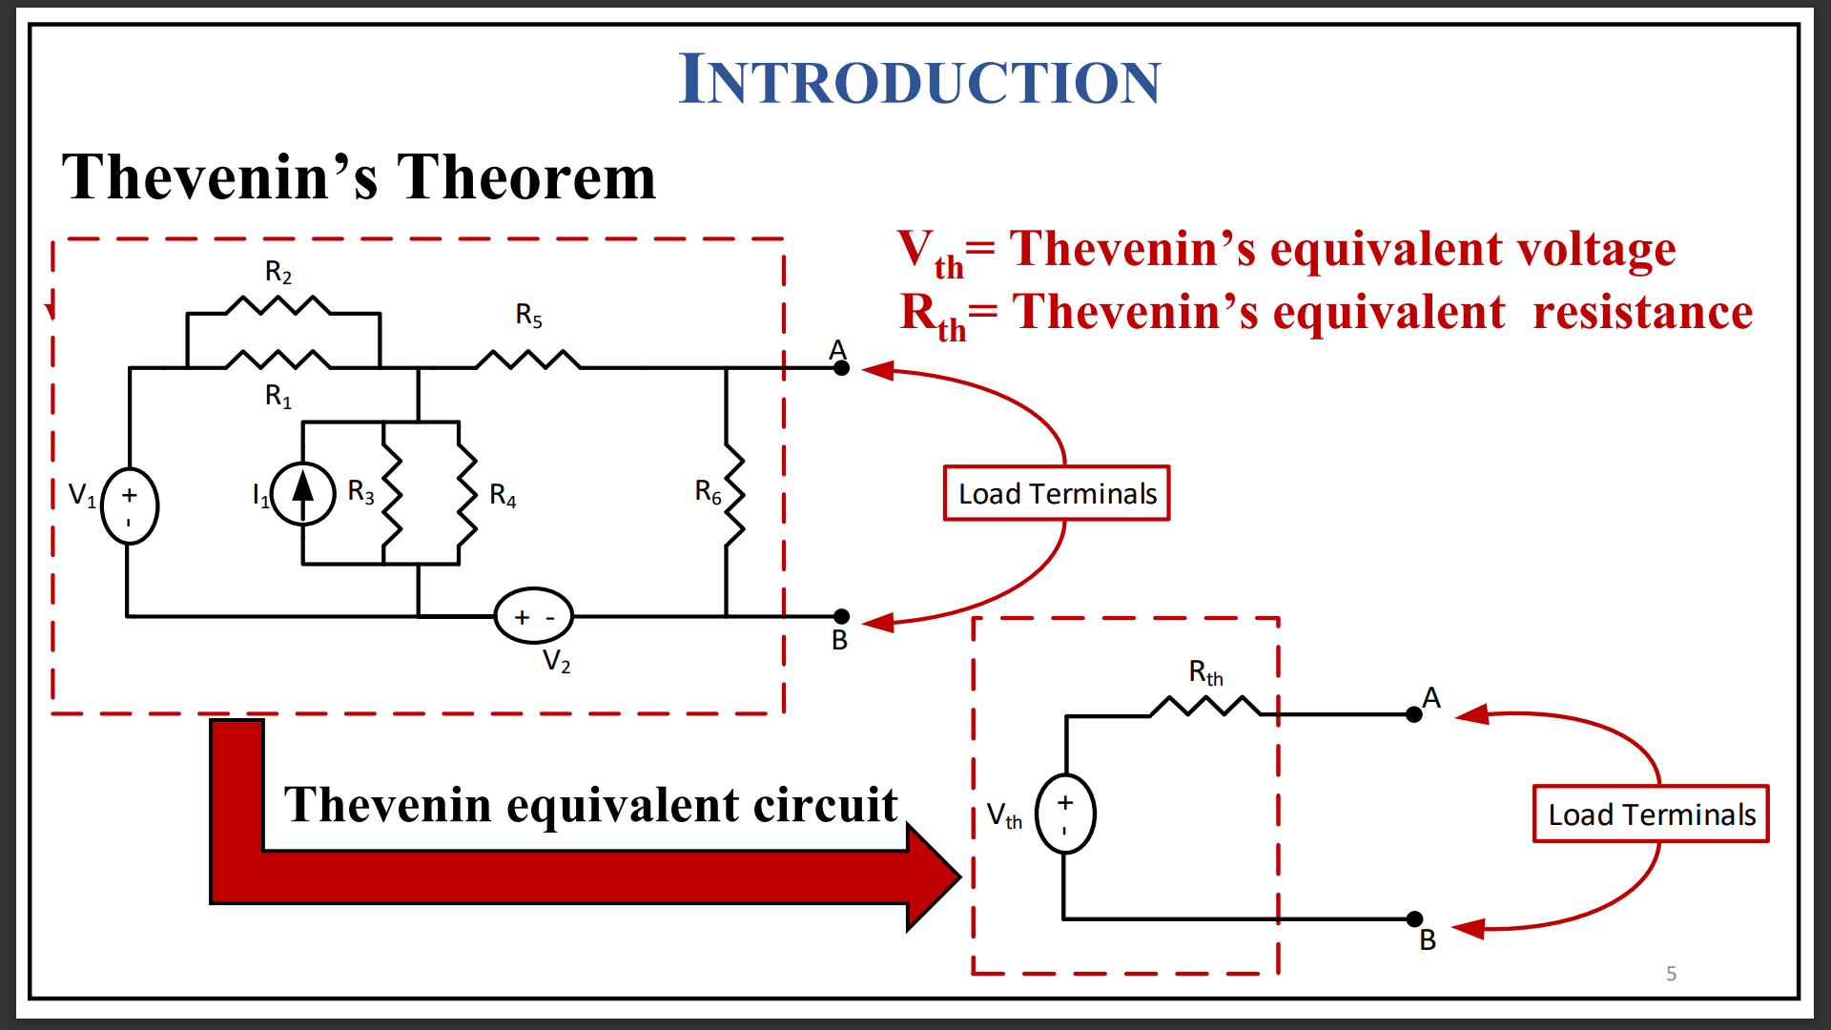

Slide 6
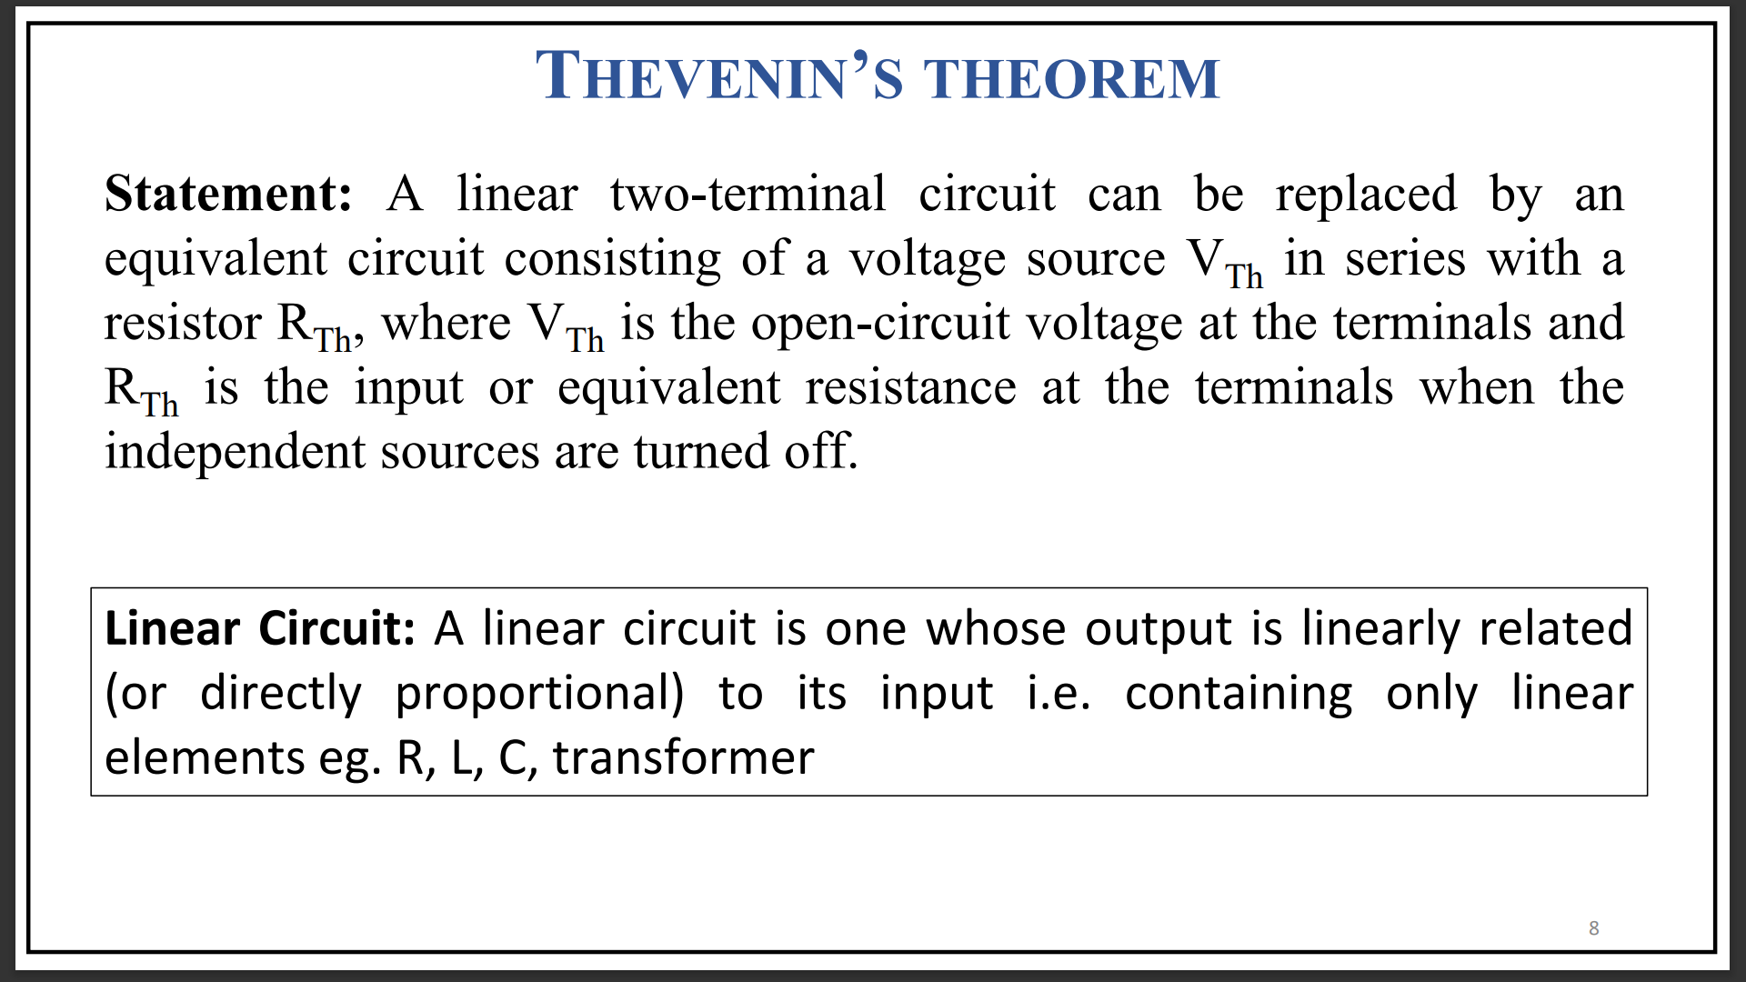

Slide 7
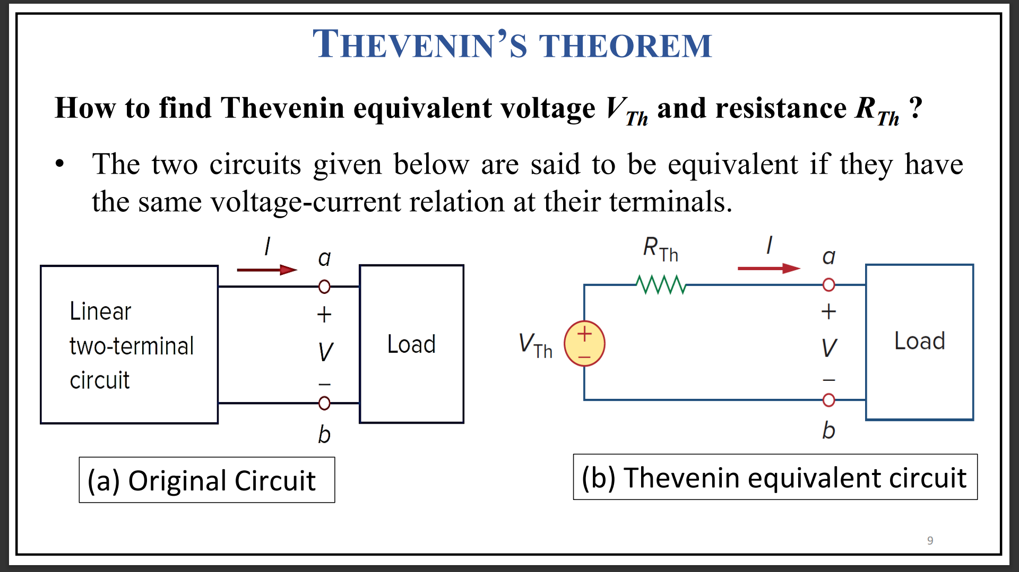

Slide 8
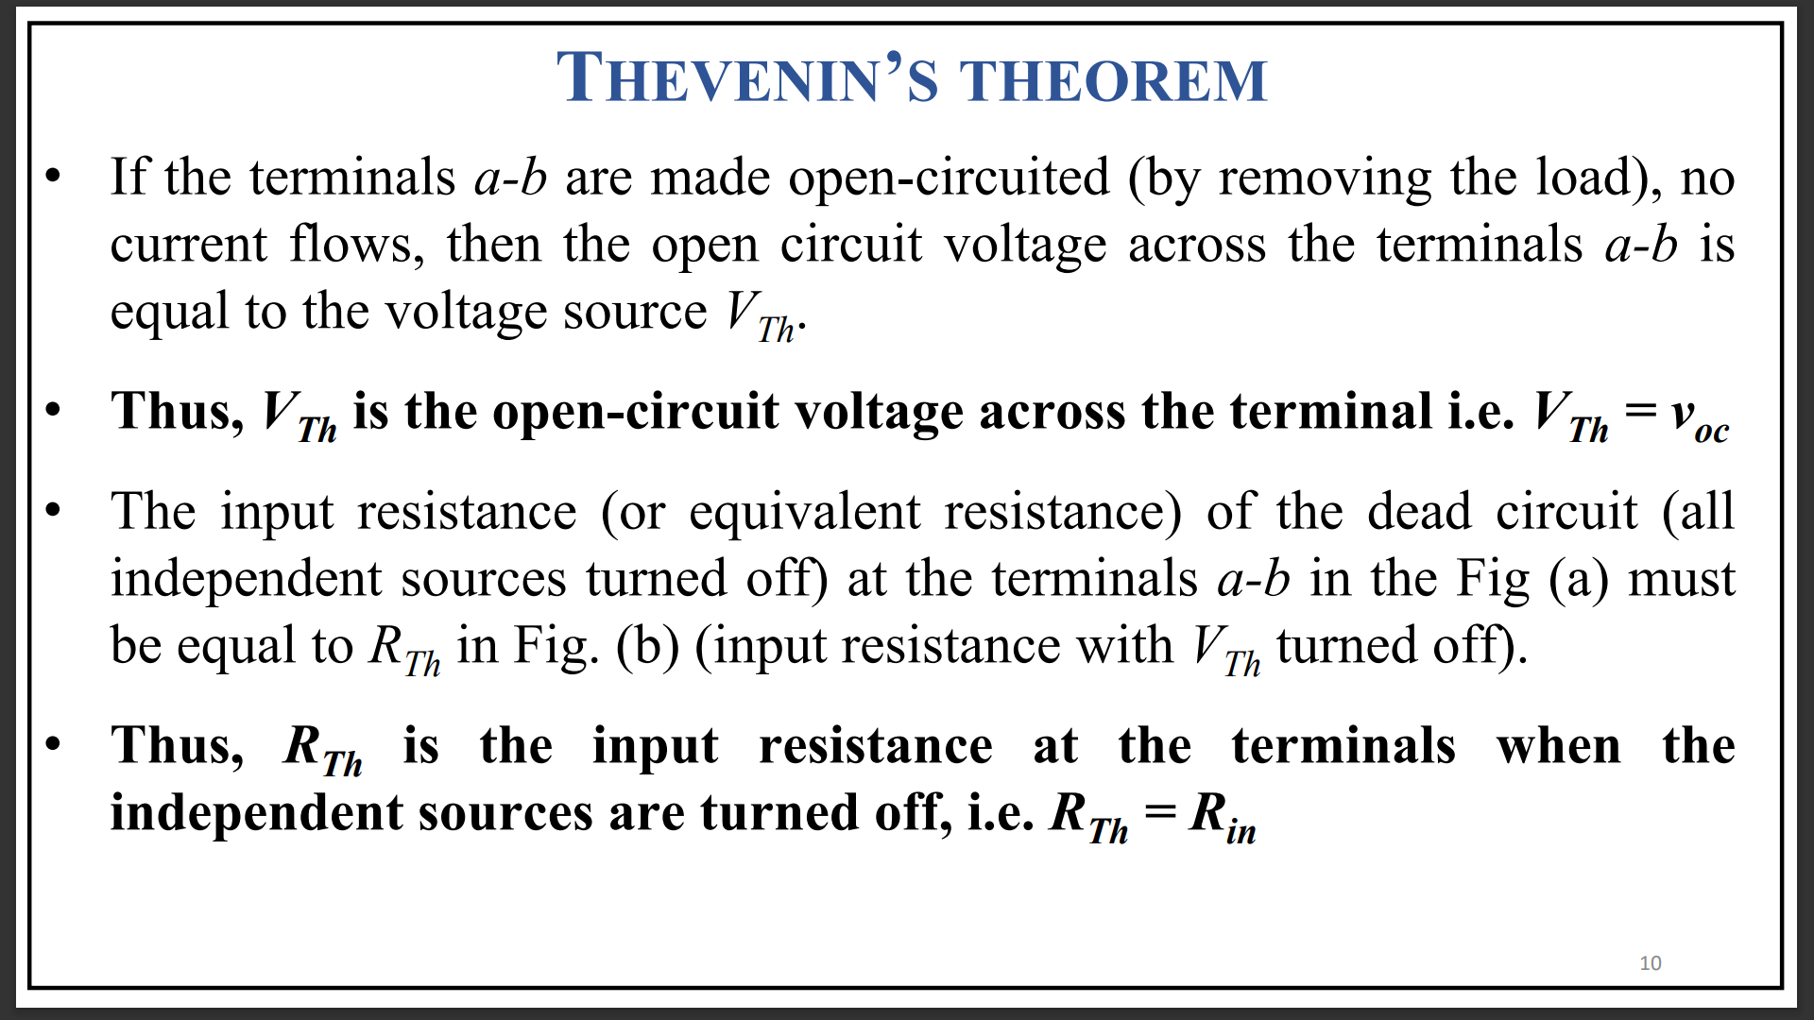

Slide 9
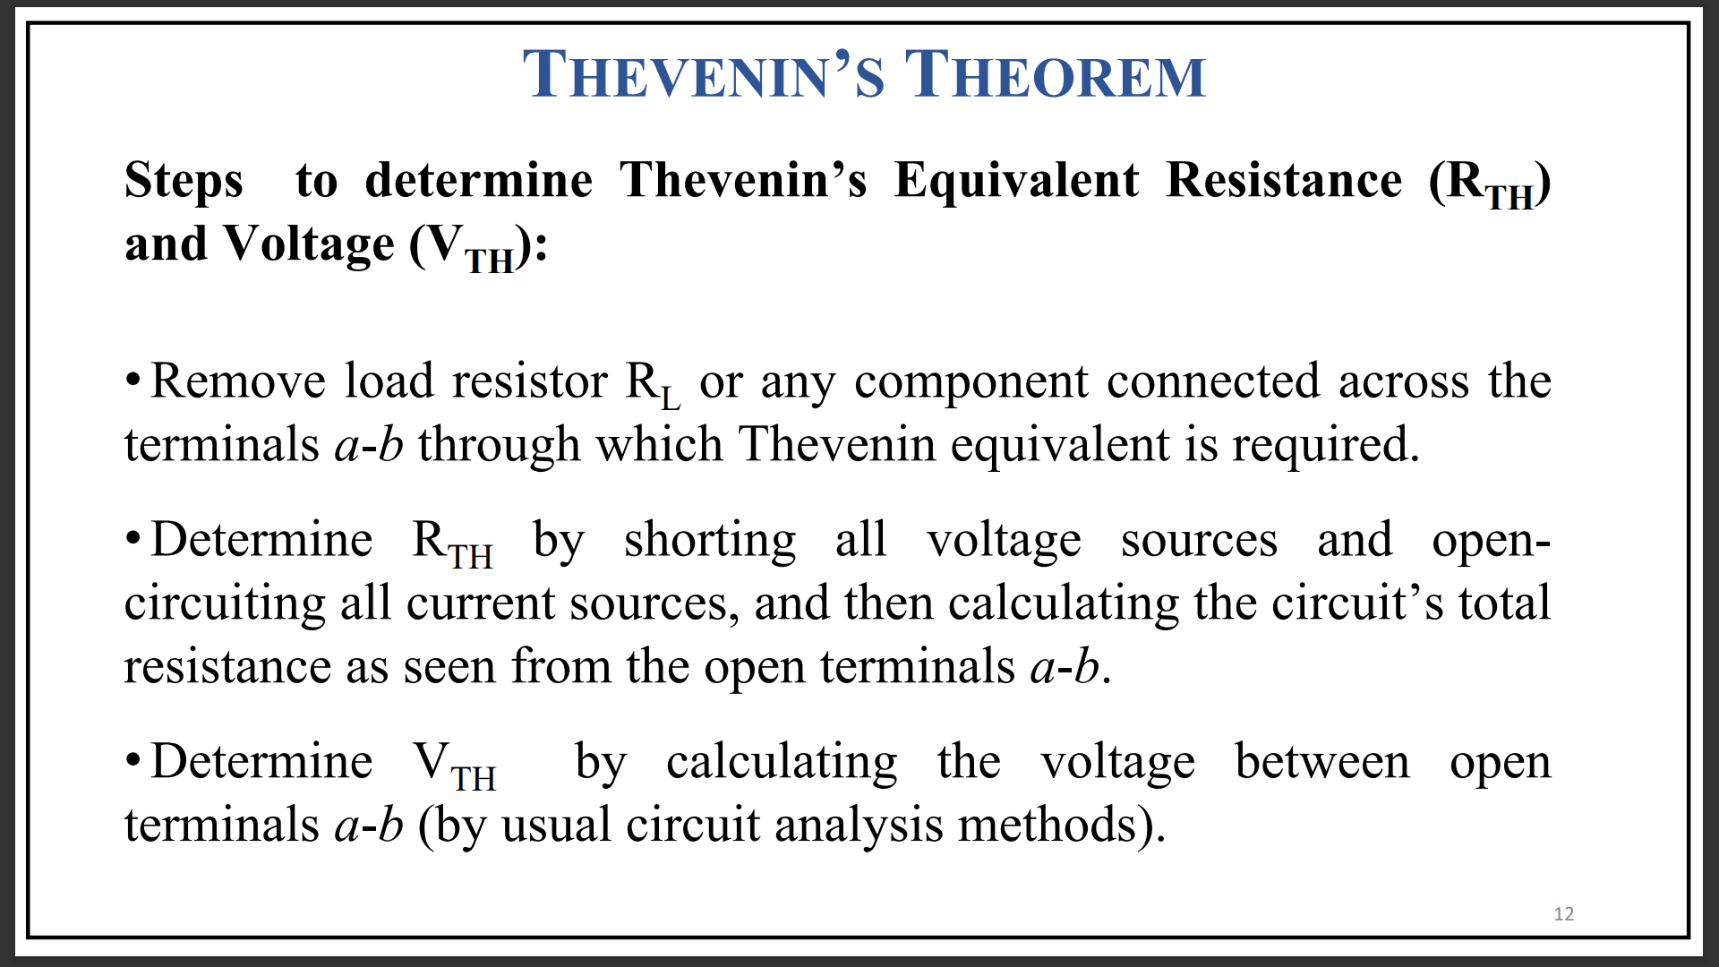

Slide 10
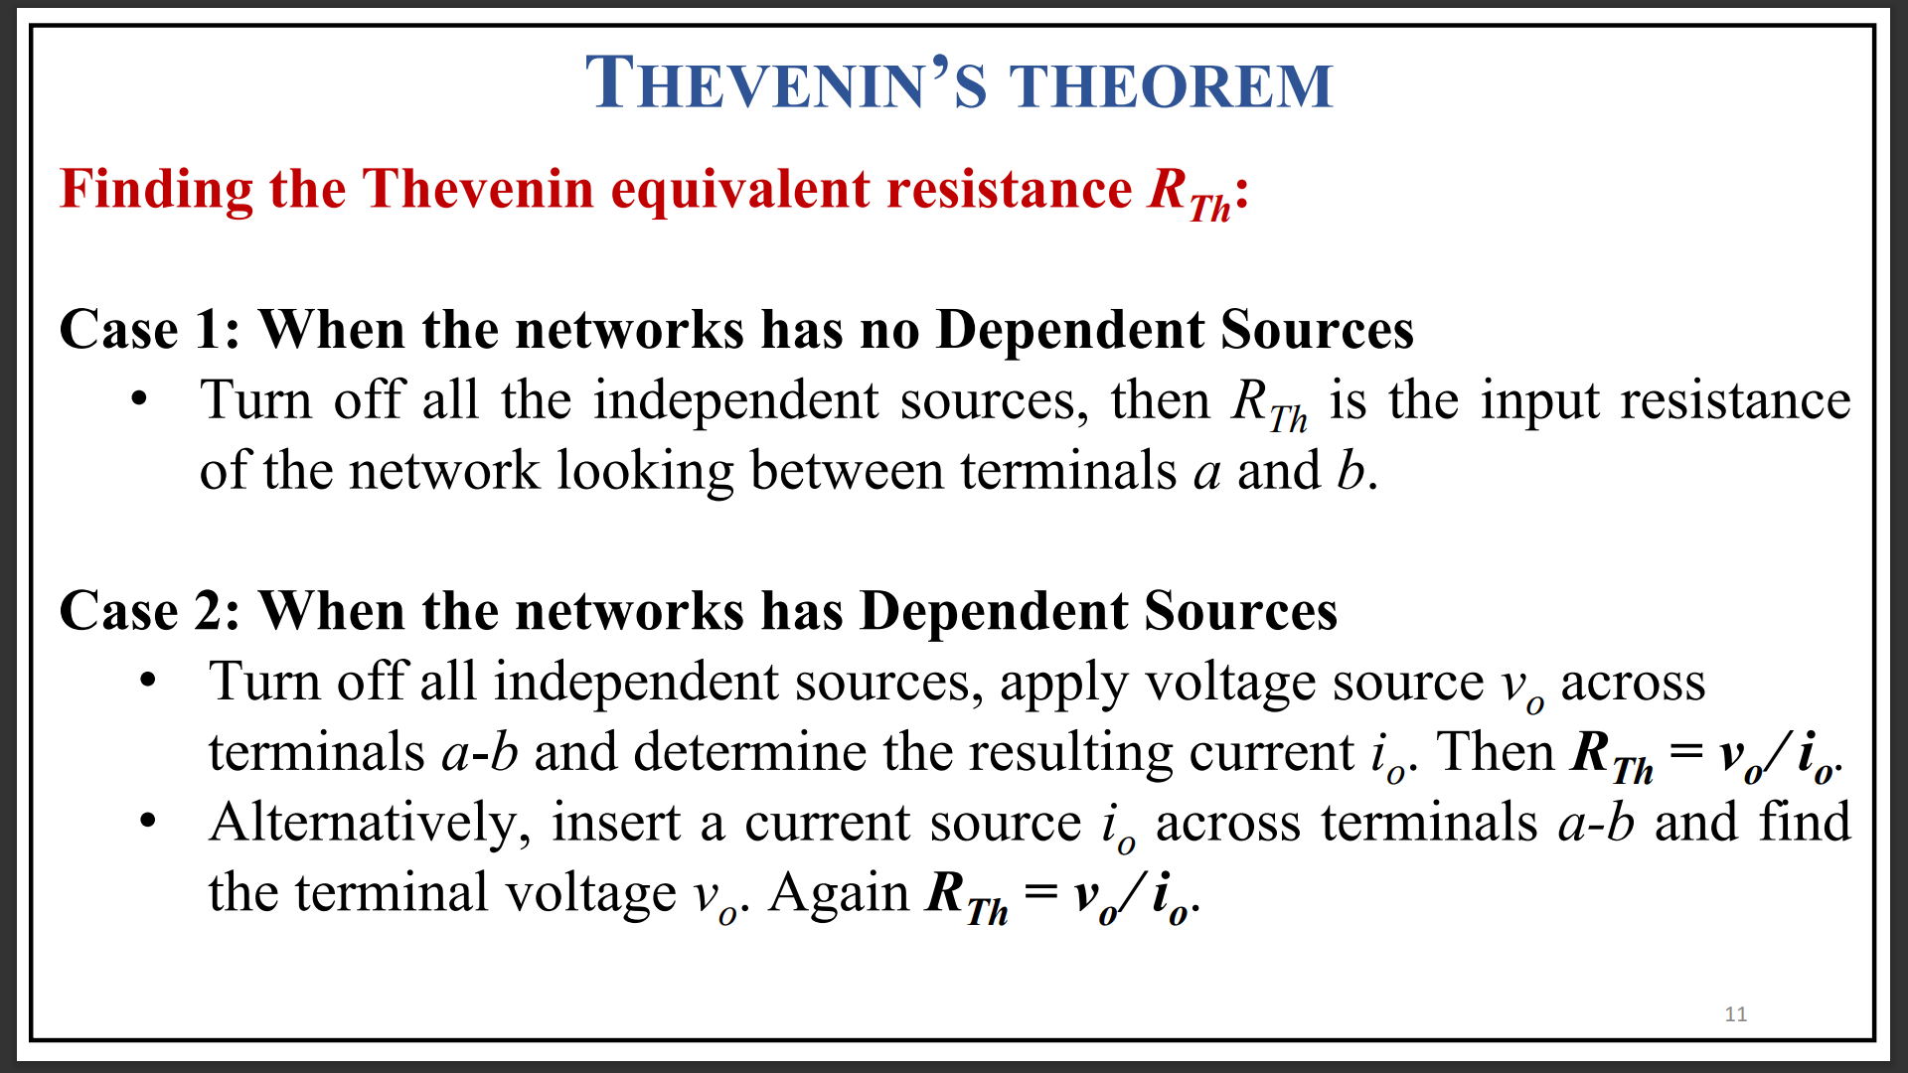

Slide 11
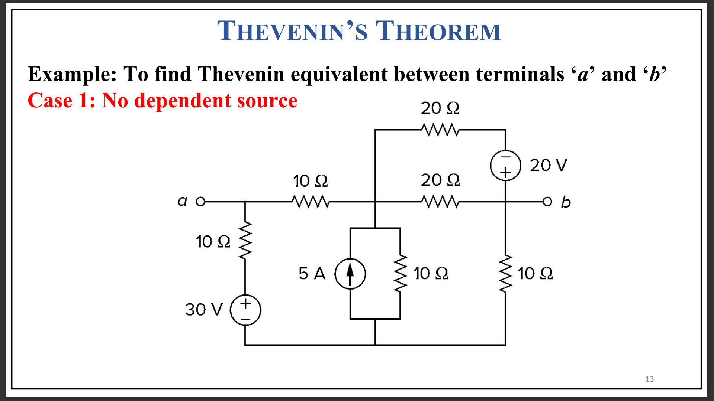

Slide 12
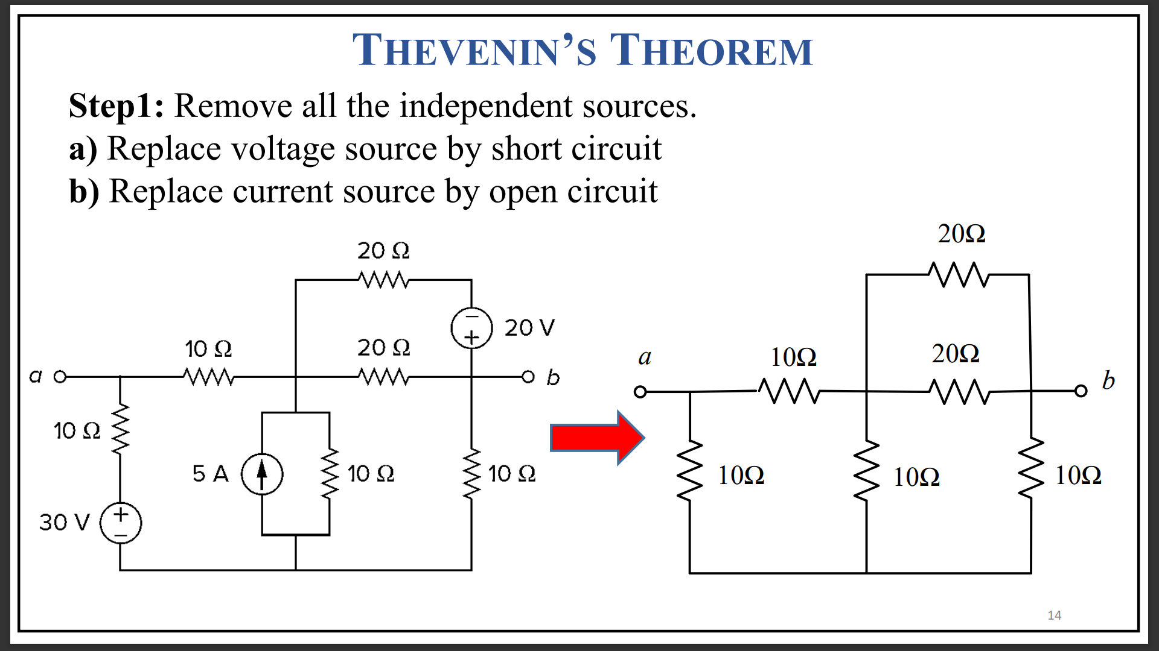

Slide 13
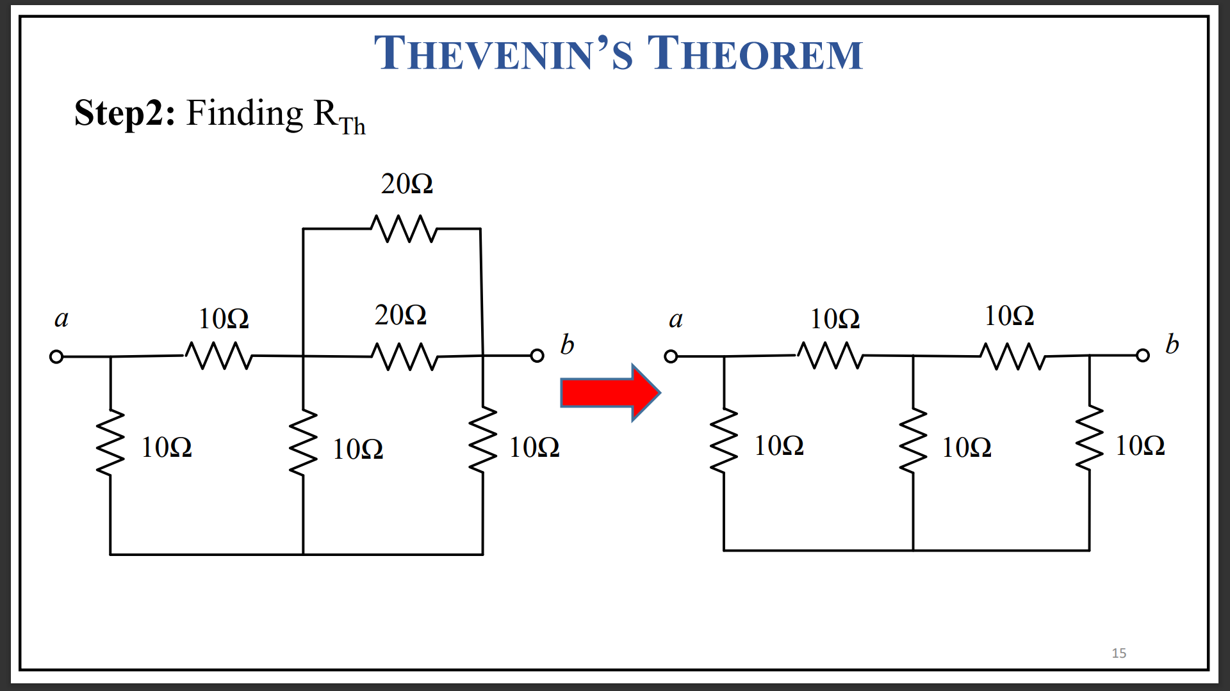

Slide 14
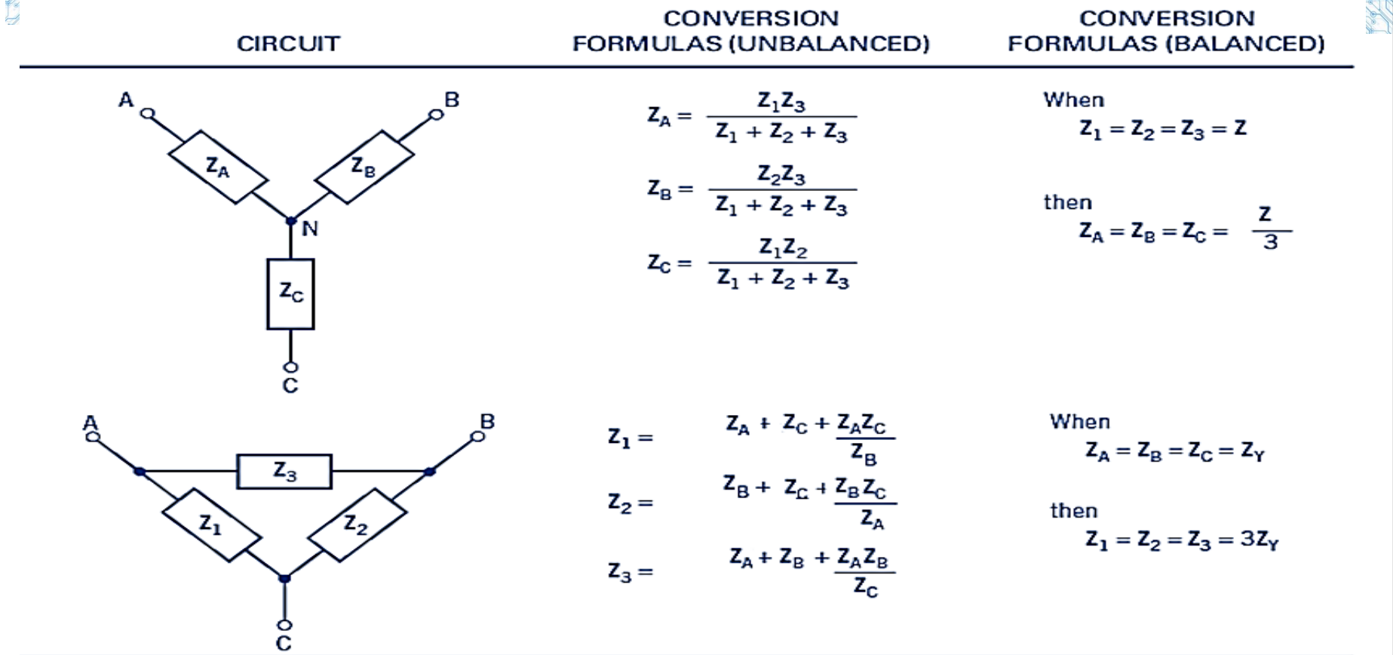

Slide 15
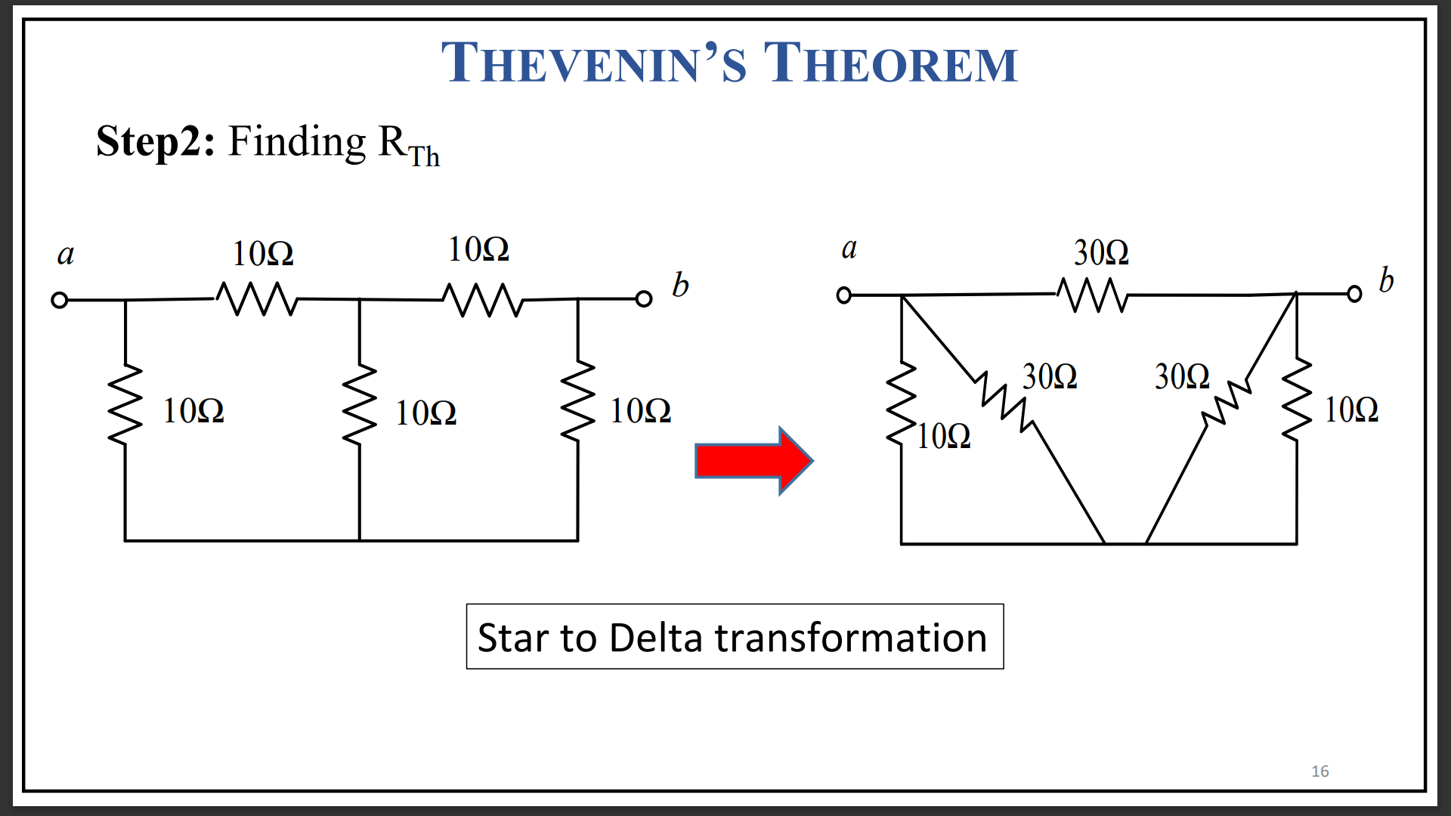

Slide 16
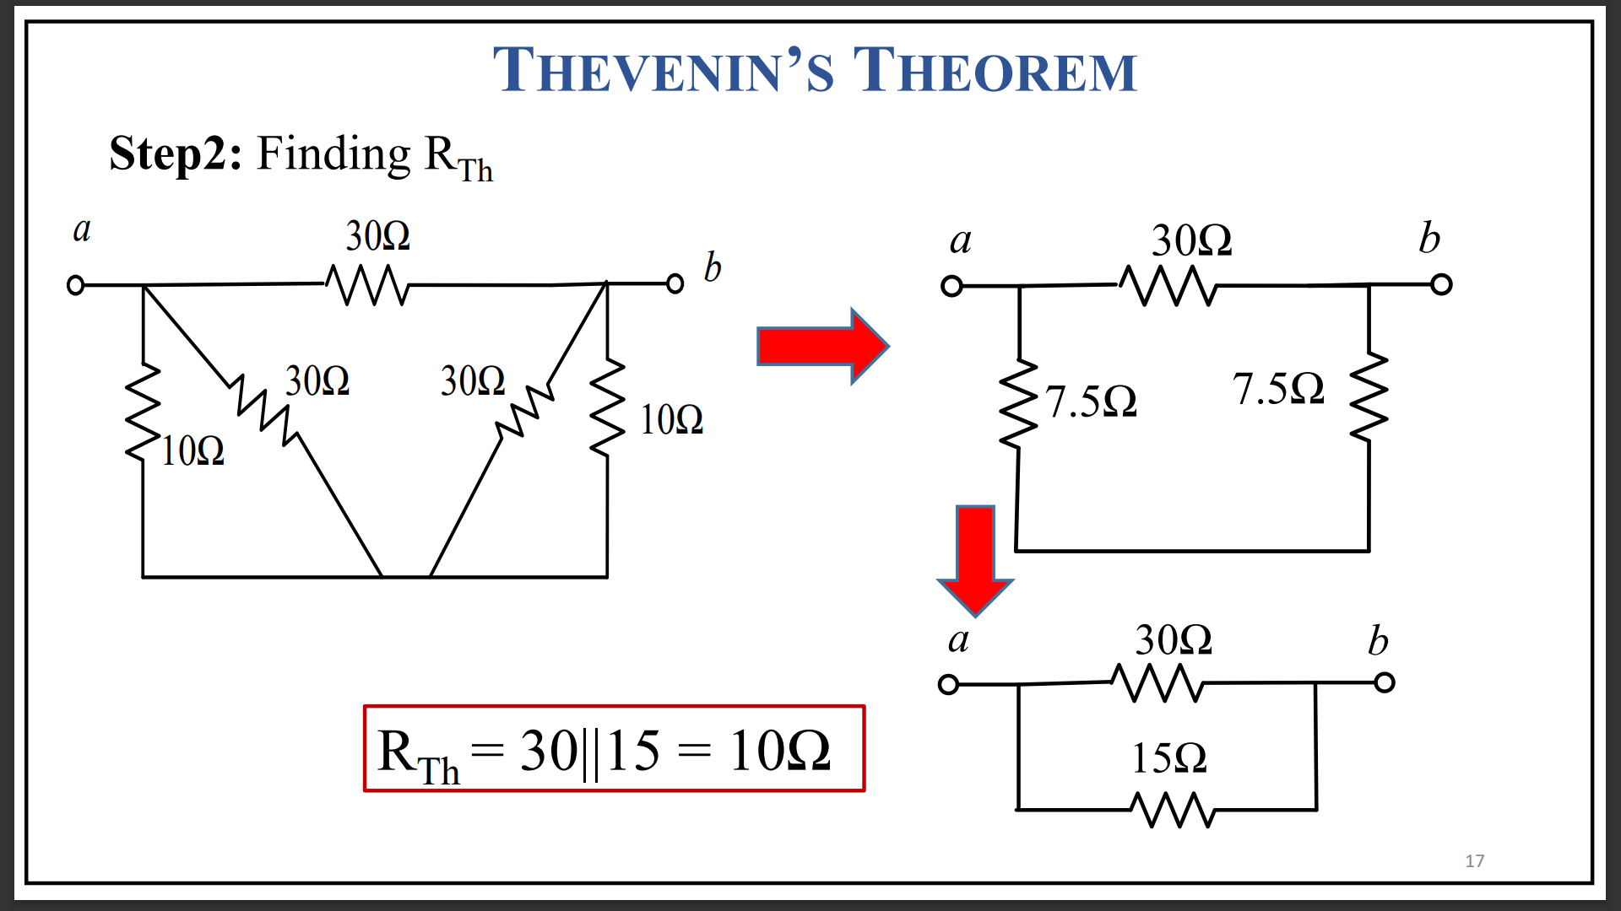

Slide 17
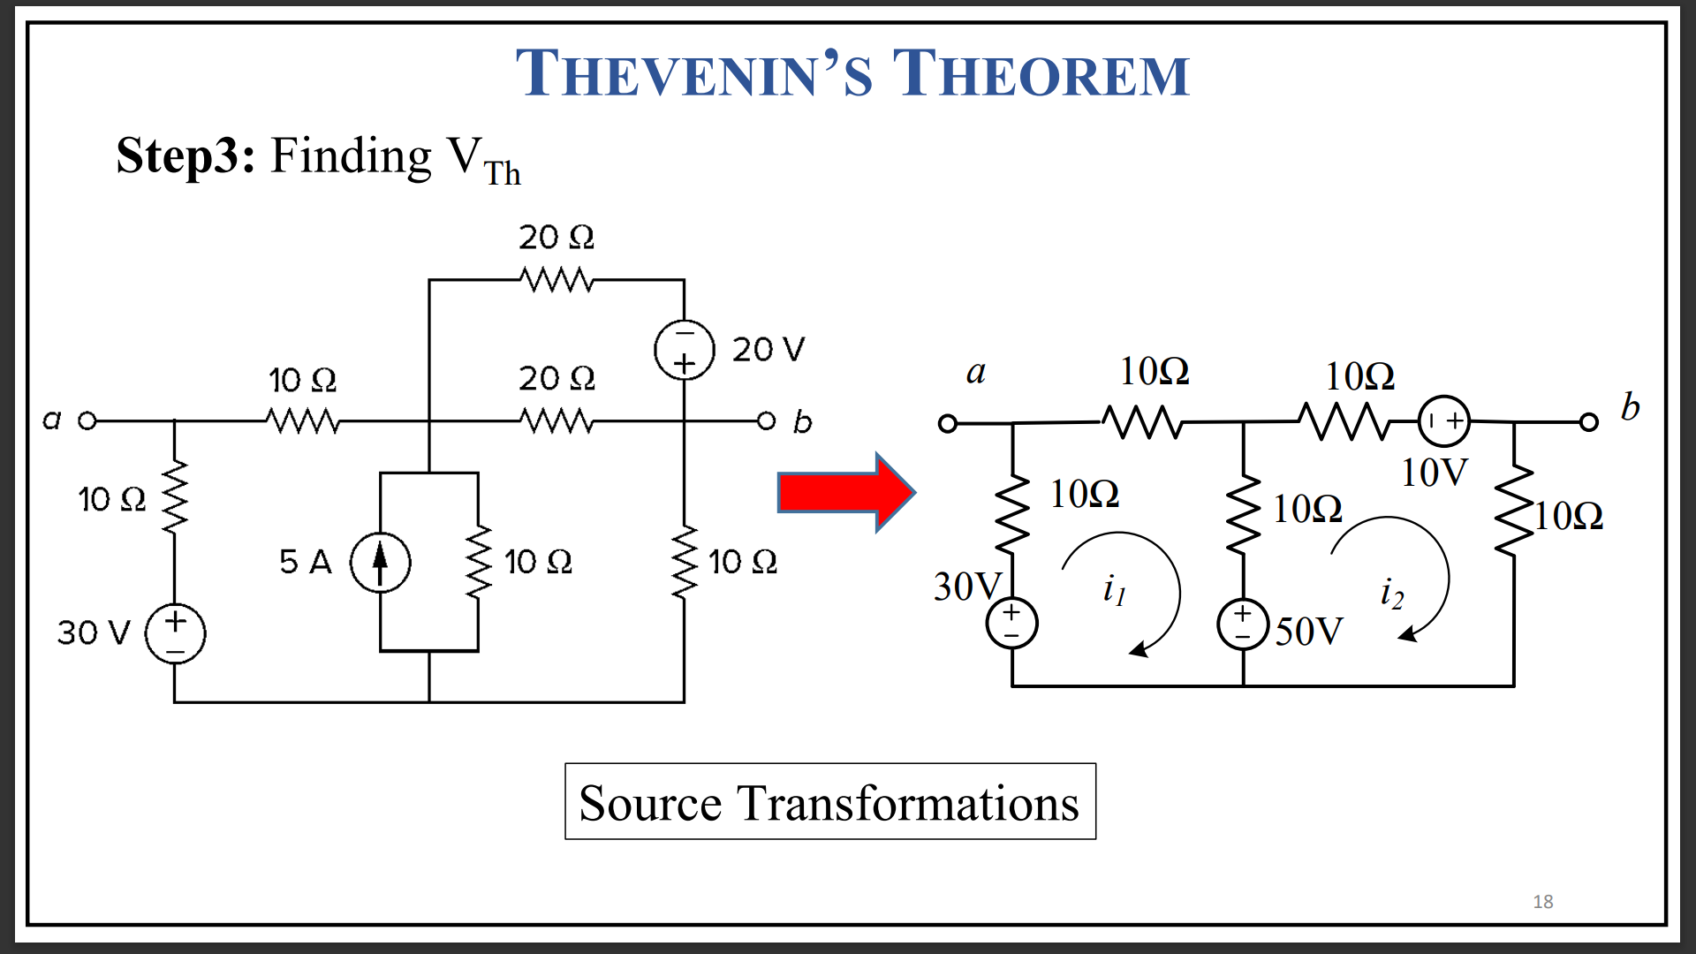

Slide 18
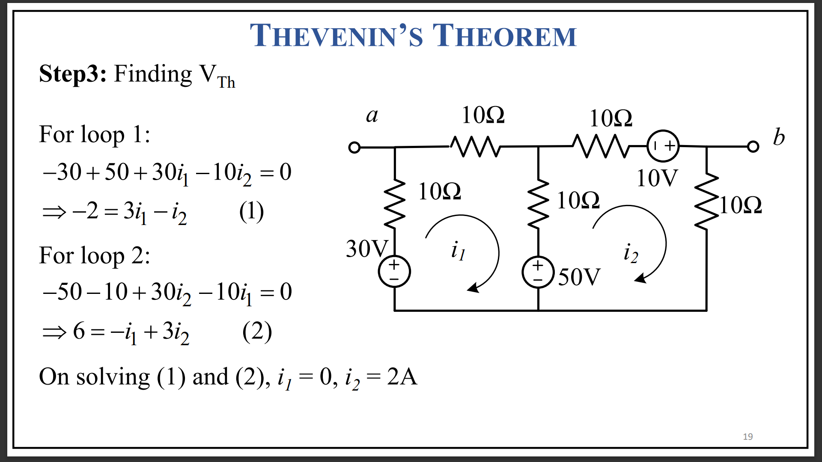

Slide 19
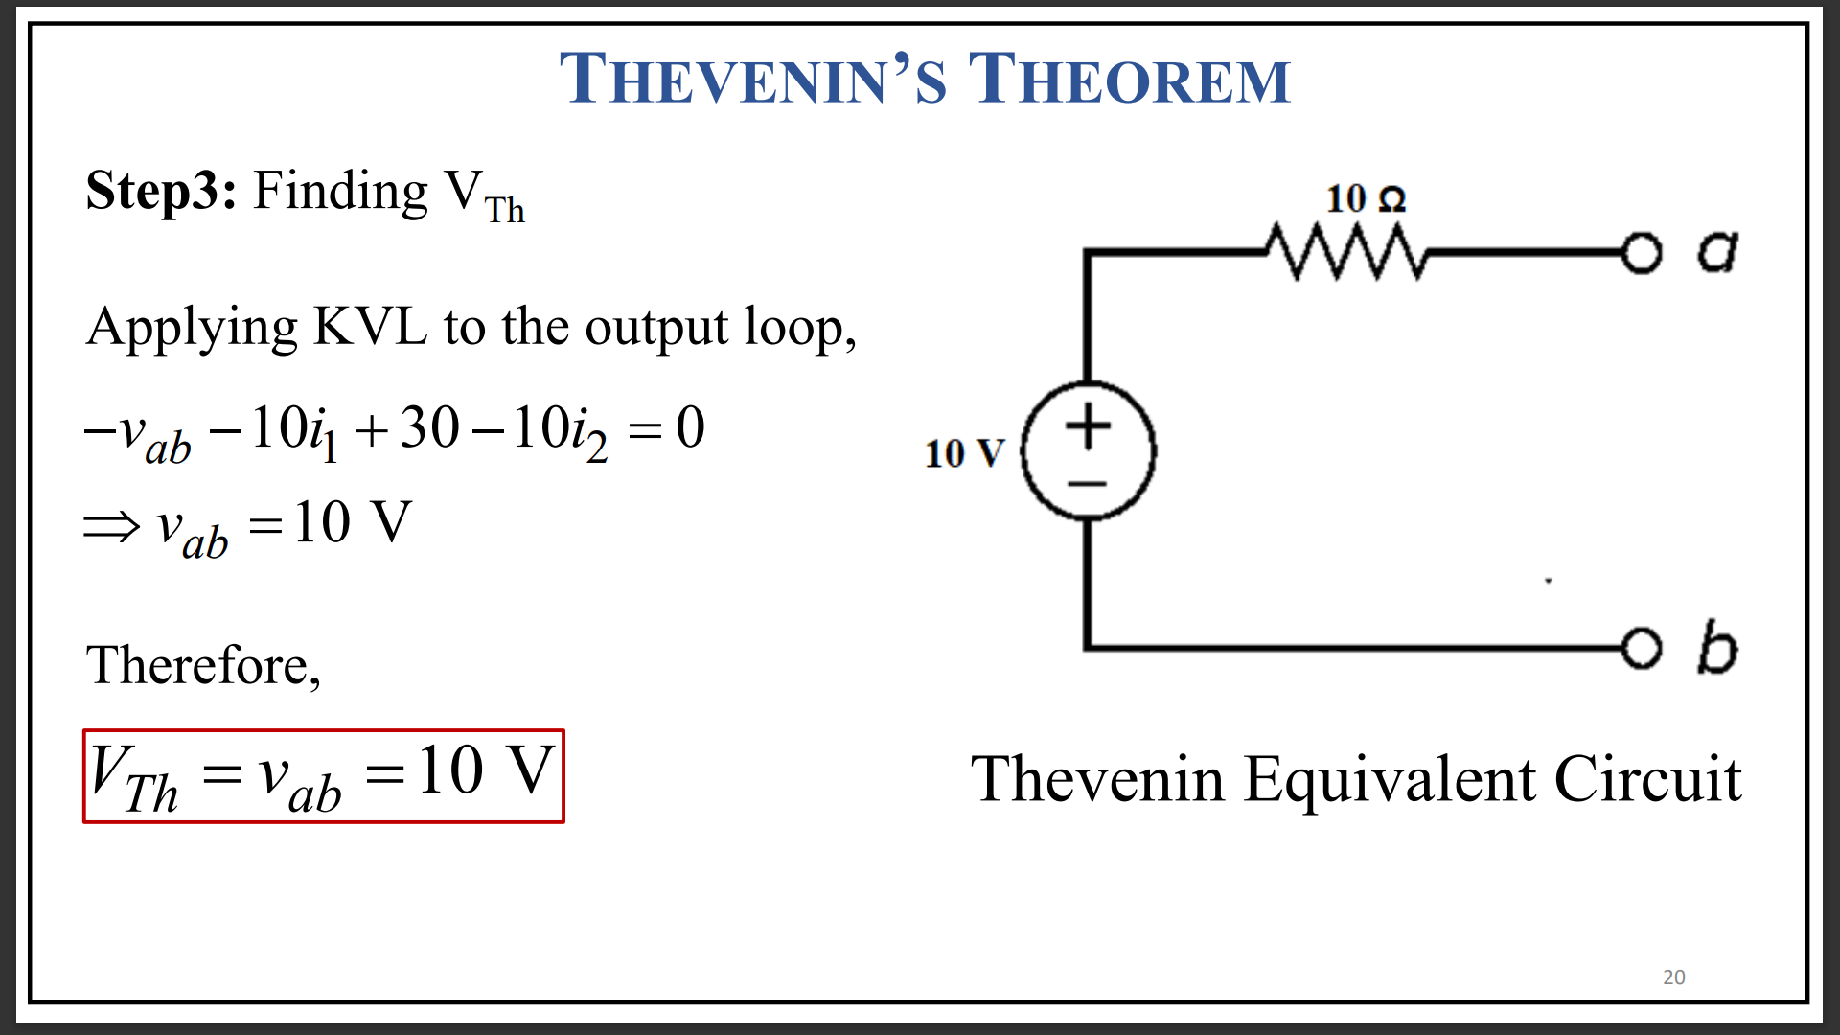

Slide 20
Thank You !!!

